Slide 1
物理类全文数据库培训 APS/OSA/SPIE
江南大学
Jiangnan University
2019

Slide 2
提纲
CONTENTS
1
物理类数据库资源介绍
课堂练习
2
检索实例分享
3
其他可用资源
4
养成良好的数据库使用习惯
课后作业

Slide 3
1
物理类数据库资源介绍
APS（美国物理学会）：成立于1899年，世界上最具声望的物理学专业学会之一，她出版的所有物理评论系列期刊分别是各专业领域最受尊重、被引用次数最多的科技期刊队伍，在全球物理学及相关学科中具有极高的声望。
OSA（美国光学会）：成立于1916年，会员以光学研究人员、制图师以及光学仪器和医学成像仪器的工程师和使用者为主，发展至今，已出版了18种期刊、8种合作出版刊、OSA主题会议录系列、三大行业会议录等。
SPIE（国际光学工程学会）：成立于1955年，专注于光电子学、通讯技术和光学成像领域的研究和应用，目前已出版11000多卷会议录和11种期刊。

Slide 4
1
物理类数据库资源介绍
Physics
Timeline
1700s – 经典力学、热力学
↓
1800s – 电磁学、物理光学
↓
1900s – 相对论、光电子学
射电望远镜被发明
Space Transition
欧洲 → 美国
Notes:
阶段一：经典物理学（力学理论，宏观低速）
阶段二：经典电磁学（逐步进入微观世界，开始为电气工程和无线通信奠基，APS诞生于美国）
阶段三：现代物理学（爱因斯坦的相对论和光电子学，普朗克的量子物理学，微观高速，OSA诞生）
阶段四：二战后，冷战促使大国开始对太空开拓，推动天文光学、航天技术和计算机技术的发展

Slide 5
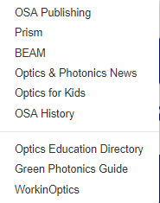
1
物理类数据库资源介绍
找到正确的入口！
学会网站 https://www.osa.org
↓
数据库网站https://www.osapublishing.org
Notes:
学会网站=www+学会英文缩写+org
先进学会网站，再找出版物板块，可以找到正确的数据库入口。
不要百度！不要百度！不要百度！不是所有学会都给自己数据库网站买热搜。

Slide 6
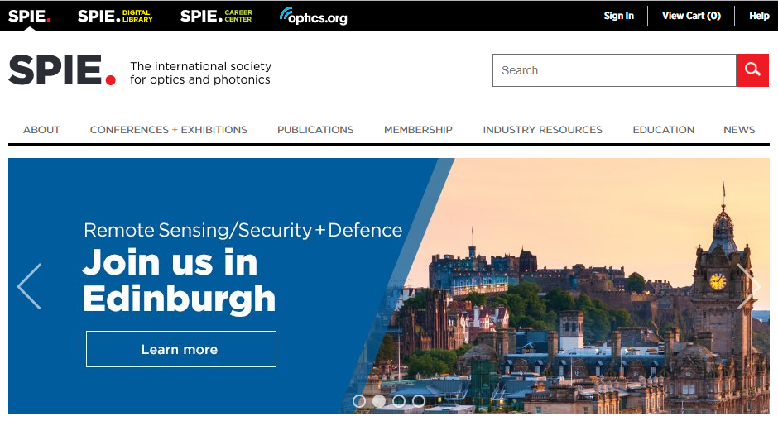
1
物理类数据库资源介绍
找到正确的入口！
学会网站 https://www.spie.org
↓
数据库网站https://www.spiedigitallibrary.org

Slide 7
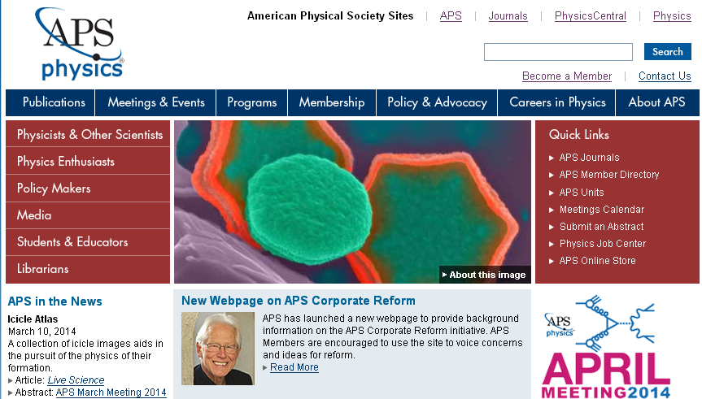
1
物理类数据库资源介绍
找到正确的入口！
学会网站 http://www.aps.org/
↓
数据库网站 https://www.aps.org/publications

Slide 8
1
物理类数据库资源介绍
General physics, Astrophysics, Nuclear physics, Dynamics, Optical physics, Plasma physics, Condensed matter and materials physics, Application in polymers, biology and climate.
APS各刊研究主题
Quantum information, Atom and molecule(incl. cold atom), High-precision measurement, Optics, Laser.
Electroweak and strong interactions, Field theory, Cosmic rays, Astroparticle, General relativity, String theory, Quantum gravity.
Accelerator science, applications, and technology,
Material design and synthesis, Crystal growth,
Thin films, Surfaces, Materials for optical use, energy generation and storage, catalysis, biomedicine, electronic devices.
Notes:
PRL: all aspects of physics and the interface between physics and other fields.
PRA: fundamental concepts
PRD: focusing on high energy physics
PRA&B: an OA journal that is funded by national and international laboratories, universities, and companies, focusing on accelerator science, applications, and technology.
PRM: all aspects of material science.
PRA~PRE receive mostly communication and comment which contains 3000~4000 words. RMP, PRX and PRReseach are the journals for full-length research articles and colloquium reports which contains 20000~50000 words.
You may check out the [author] section of each APS journal.

Slide 9
1
物理类数据库资源介绍
Innovation to the existing theory, research method, paradigm or application of physics.
APS各刊研究主题
Structure and phase, Superconductivity, Semiconductors, Magnet, Electronic structure, Photonics, Surfaces, Nanomaterials, Topology in soft matters.
Complex fluids, Polymers, Liquid crystals, Granular materials, Solid mechanics, Fluid dynamics, Plasma physics, Computational physics, Networks, and Complex systems.
Biomedical engineering, Device, Renewable energy, Geophysics, Nanotechnology, Optoelectronics, Quantum information processing.
Teaching and learning
Notes:
PRX: innovation is a must! OA journal!
PRB: all aspects involving Condensed Matter and Materials Physics, which makes up the foundation of electronic engineering.
PRE: a very cross-disciplinary journal, mainly involving statistical, nonlinear, biological, and soft matter physics,
PRAp: makes up a bridge between engineering and physics
PRPER: experimental and theoretical research relating to the teaching and learning of physics and astronomy

Slide 10
1
物理类数据库资源介绍
Atomic, Molecular, Optics, Chemical physics
Condensed matter physics, Plasma physics and fusion, Particle-beam physics, Nuclear physics
High-energy physics, Computational physics
APS各刊研究主题
Nucleon-nucleon interaction, Few-body systems, Nuclear structure, Nuclear reactions, Hadronic physics, Electroweak interaction
Acoustids, AI, Astronomy, Climate, Earth and environment, Materials, Electonics and devices, Nuclear, Optics and optoelectronics, Polymer, Scientific machine learning.(OA)
Combustion fluid, Electrohydrodynamics, Biomedical flow, Drops, Bubbles, Turublence, Vortex, Wave.
Notes:
RMP: all aspects of physics in the form of review article. Find nobel laureates’ lecture in this journal!
PRC: a trusted venue for nuclear scientist
PRR: all aspects of physics in the form of full-length research article, incl. fundamental and applied research, theoretical and experimental demonstration, and report on research technics and methodology. A recently launched OA journal.
PRF: fluid dynamics in industry, bio-system, environment and at micro-and-nano scale.
2019年内提交至PRR的稿件，一旦被接受，可免除开放发表费用！2019年后收到的稿件，开放发表的费用为2200刀

Slide 11
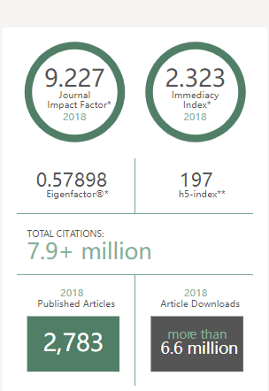
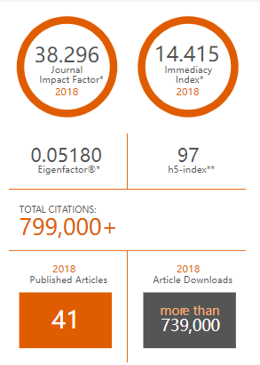
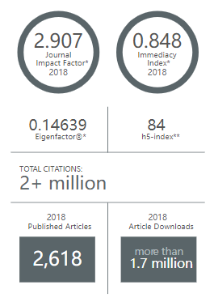
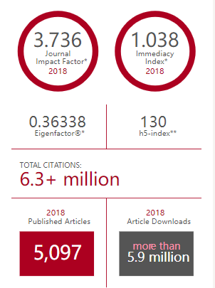
1
物理类数据库资源介绍
权威期刊
APS TOP Journals
Physical Review Letters
Reviews of Modern Physics
Physical Review A
Physical Review B
Notes:
TOP by IF:
Among 80+ multi-disciplinary physical journals, Review of Modern Physics ranks as top 1 by its impact factor, 38.296.
TOP by Citation:
Among more than 80 multi-disciplinary physical journals, Physical Review Letters has more citations than the others, which is 7.9 million. And its IF ranks as high as number 6.
Among more than 90 optics journals, Physical Review A has the most citations as 2 million.（被引量第二多的是OSA的《光学快报》）
Among more than 60 condensed matter physics journals, Physical Review B has the most citations as 6.3 million.
*However, because of the great number of articles they publish per year, their impact factors are not very high. （都是个位数）
一般来说谷歌学术的H因子在100左右就不错了。一本刊的H因子越高，它被引用的文章数量就越多。有些期刊影响因子高但H因子低，说明引用量集中在一小撮文章！

Slide 12
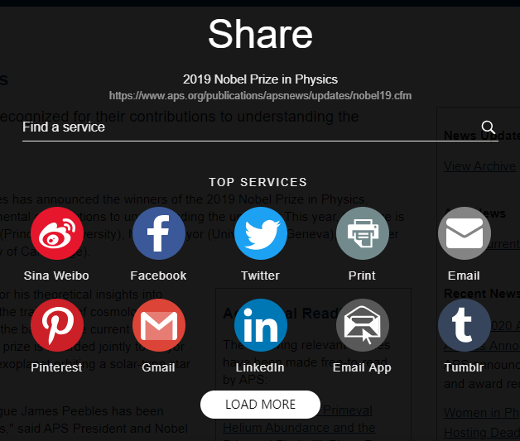
1
物理类数据库资源介绍
权威期刊
APS TOP Journals: PRL
PRL authors gain rapid publication and achieve broad dissemination of their work in the most cited journal in physics.
Editors’ Suggestions
Featured in Physics
Collections
Publicity: NYT, BBC, Nature
Social Media
Notes:
PRL每80秒就有文章被人引用。
PRL在2018年里发表的文章里，约有17%来自中国研究机构。
Publicity: APS promotes press-worthy papers from its journals to journalists through a weekly Tip Sheet, resulting in frequent appearance in popular press, such as the New York Times, BBC, and Nature.

Slide 13
1
物理类数据库资源介绍
权威期刊
什么是“快报 (Letters)”？
【简短】和【直奔主题】
【创新性】和【启迪性】
从【投稿】到【最终发表】流程较短
更容易被学术杂志和媒体转载
其他短文章
3,750 words
min: 3 months
Physical Review Letters
Notes:
No long introduction to your previous work, usually no more than 4 figures.
No matter this innovation is fully proven or optimized, you can have it published to claim a place as long as it falls in the interest scope of this journal.
Letters are more likely to be mentioned by public media, so they tend to have more readers.
APS journals not only publish letters, but also viewpoints and comments, showing theoretically-proven insights to a specific problem.

Slide 14
1
物理类数据库资源介绍
权威期刊
什么是“快报 (Letters)”？
一篇好的快报是怎么样的？
可以影响甚至改变他人对物理学现象的理解
体现出分析或实验的可操作性
有详有略，突出重点
“说明书文风”
Physical Review Letters
请参考：
https://doi.org/10.1103/PhysRevLett.100.100001
Notes:
影响他人——你的研究（或多或少）可以影响到其他学科领域的读者
可操作性——读者可以重复你的实验甚至在你研究的基础上做出改进或联想
突出重点——突出你的研究中与结论或问题最相关的部分，撇去琐碎的步骤或细节，便于科技杂志或媒体转述
说明书文风——现有理论、研究方法论或实践方法中需要探讨的问题是什么、给出这个问题在什么条件下被探讨、最终结论或解决方案是什么，尽量少用形容词和虚词。
每次提笔之前，都需要思考：自己的研究方向在整个物理学界的地位如何？有没有重视它的必要？你的研究可以促使他人重视它吗？然后将这些信息放到cover letter或introduction中，并在文末的总结部分点一下题或是做一下合理联想。

Slide 15
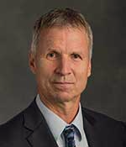
2
检索实例分享
了解编辑团队
主编
Dr. Michael Thoennessen
Distinguished Professor
Department of Physics & Astronomy
Michigan State University
Physical Review Letters
Notes:
EiC is the one who set a benchmark for the whole journal.

Slide 16
2
检索实例分享
了解编辑团队
编辑团队
Hugues Chaté
CEA-Saclay, France
非线性动力学、统计物理学
Reinhardt B. Schuhmann
Full-time APS editor
凝聚态物理、核物理
Robert Garisto
Canadian National Lab, Canada
理论高能物理
Frank Narducci
Atomic physics group, Naval Postgraduate School, US
航海传感器、量子相干性
Robert Garisto
Albert Einstein College of Medicine, US
半导体、二维材料、中观系统
Deniz van Heijnsbergen
R&D department of ASML
光刻
更多编辑团队信息：https://journals.aps.org/edannounce
Notes:
But Divisional Associate Editors are usually those who really contact you through the process of publishing. They work actively in difference places around the world, which makes it easier for local authors to contact or meet them. They first make decision on the importance, relevance and originality of your manuscripts. If acceptable, they will pass it to peer reviewer in the same research area(usually two~four), and then collect their opinions. All members at APS editorial board are university lecturer/professors and doctoral or post-doctoral researcher in professional institutions.
右下角是APS期刊编辑公告网页：除了编辑介绍，还能找到获奖研究者的信息！

Slide 17
2
检索实例分享
了解编辑团队
2019年9月 | Physics and Life
2016年8月 | Hybridizing Quantum Physics and Engineering
2019年6月 | Avoid the Tragedy of the Commons
Notes:
在编者按中，读者可以找到主编或副主编在一个时间段内，为自己的期刊所设定的主题或方向以及编辑团队对稿件的偏好，其目的是，通过明确的主题来吸引志同道合的研究人员，集中呈现该主题的研究成果；或者是告诉现有作者和读者，自己的期刊有了什么新的发展方向、与哪个研究机构有了跨学科的创新合作、在稿件处理中碰到了哪些问题。比如PRL最近提出的物理学与生命科学交叉领域研究，比如说人体组织电流现象

Slide 18
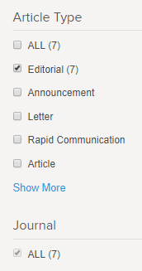
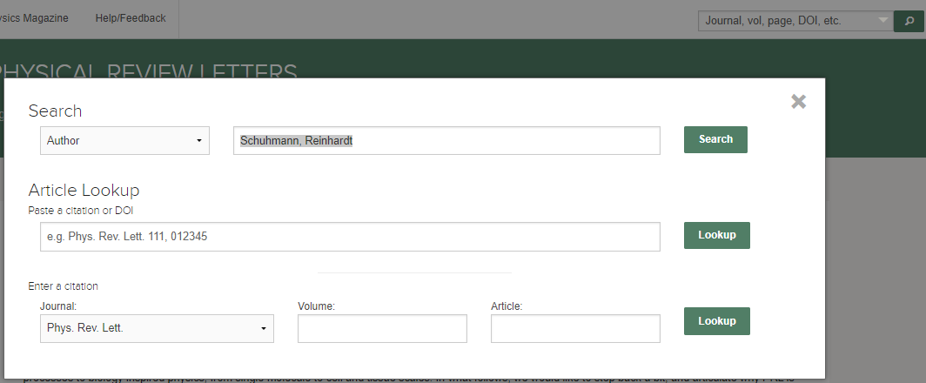
2
检索实例分享
了解编辑团队
课堂练习：Reinhardt Schumann → Schuhmann, Reinhardt as AUTHOR

Slide 19
2
检索实例分享
热门话题
量子相干性
Quantum Coherence
凝聚物
Condensates
马约拉纳费米子
Majorana fermion

Slide 20
2
检索实例分享
热门话题
课堂练习：quantum coherence → “quantum coherence” in Abstract/Title
condensates → condensat* in Abstract/Title

Slide 21
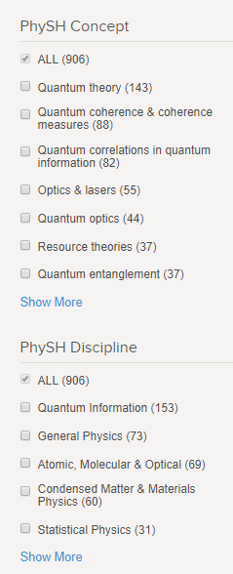
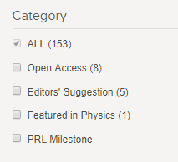
2
检索实例分享
热门话题

Slide 22
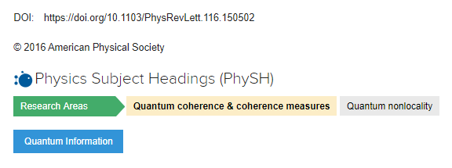
2
检索实例分享
热门话题
更细的研究方向
分支学科
Robustness of Coherence: An Operational and Observable Measure of Quantum Coherence

Slide 23
2
检索实例分享
热门话题
那什么是【编辑推荐】栏目？
推荐具有广泛应用意义的文章
每周经由每种期刊的编辑团队二次挑选
集中呈现于期刊主页的【Highlight】板块
Notes:
目前已实施12年，占APS期刊文章总数的六分之一多。将该栏目的文章集中起来计算总影响因子，可达到10以上；该栏目中有三分之一的文章被科技杂志或媒体报道。
They can garner twice as many downloads and citations as the average letter and are more frequently covered by news outlets.

Slide 24
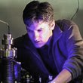
2
检索实例分享
热门作者
量子相干性
Christopher Monroe
马约拉纳费米子
Charles L. Kane
Notes:
举例：马里兰大学物理学教授克里斯托弗·蒙罗、宾州大学的物理学教授查尔斯 L. 凯恩。分别是量子物理学和理论物理学的现代的大牛

Slide 25
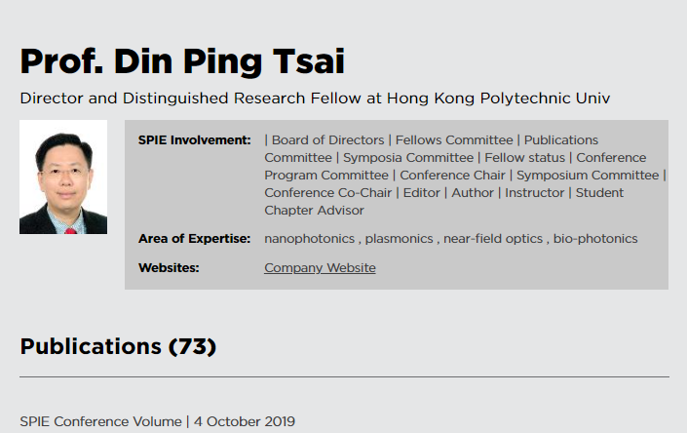
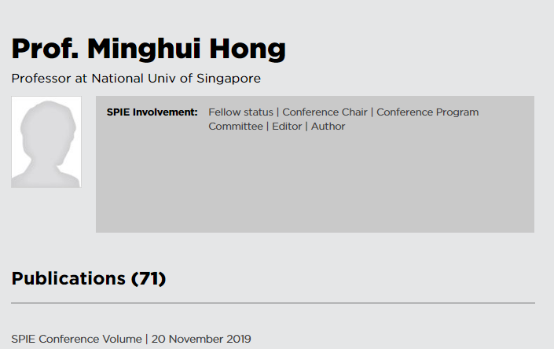
2
检索实例分享
SPIE作者
蔡定平
Din Ping Tsai
洪明辉
Minghui Hong
Notes:
在SPIE中检索作者：光电子领域专家、港理工教授蔡定平；激光制造领域专家、新国大教授洪明辉为例。。。
在SPIE数据库网站中建立自己的档案页，可以把自己课题组/公司的网站链接放上去。

Slide 26
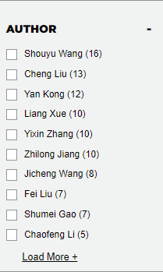
2
检索实例分享
SPIE作者
在SPIE数据库检索：作者所属机构为“Jiangnan”，检索结果左栏出现作者投稿时所用的姓名。
Notes:
检索“Jiangnan”后，发现排在第二、第三位老师都来自江南大学，但是，他们都没有在SPIE数据库网站建立自己的Profile Page。

Slide 27
2
检索实例分享
热门研究机构
东京大学
Tokyo University
ESI ＜10%
清华大学
Tsinghua University
中国科学技术大学
USTC
Notes:
亚洲物理学领域ESI高排名学校

Slide 28
2
检索实例分享
热门研究机构
课堂练习：Tsinghua University → 100084 in AFFILIATION
Notes:
在【作者所属机构】中检索【清华大学邮编】
为什么要搜邮编？
避免重名，比如台湾的国立清华大学和大陆的清华大学；
避免更名，比如北京交通大学之前叫北方交通大学；
避免一校多名，比如有些中科大作者喜欢缩写自己所属单位的名称、天津工业大学又叫Tianjin Polytechnic University、又叫Tiangong University。
注意：APS的待刊文章是搜不到的！只能通过每种期刊的【Accepted】栏目来浏览。查全的时候务必记得去浏览查看！

Slide 29
3
其他可用资源
会议和研讨会
Upcoming events in 2020
APS National Mentoring Community Conference 2020
February 6-8, 2020 | Orlando, USA
APS PhysTEC Conference February 29-March 1, 2020 | Denver, USA
OSA Recent Advances in Wire-Based Additive Manufacturing
9 January 2020 | ONLINE
OSA The 22nd International Conferemce on Ultrafast Phenomena 19 - 24 Jul 2020 | Shanghai CHINA
Notes:
对在读研究生有用的其他资源
第22届国际超高速现象会议
Submission site will open in mid-December 2019
Requirements
35-word Abstract: Your abstract should be a brief summary of your paper topic. If your paper is accepted, your 35-word abstract will be included in the Conference Program. Note that the same abstract should be included in the 2-page summary as highlighted in the style guide.
2-page Summary: All contributed authors are required to submit a final summary of their work for publication in the Technical Digest, via OSA Publishing's Digital Library. Style guides are provided in a variety of different formats to support authors’ needs. All PDF submissions MUST contain the following items in order to be published:
Complete title
Complete listing of all authors and their affiliations
Self-contained abstract, limited to 35-words (indexers such as Google Scholar will not index papers that do not contain abstracts)
Appropriate copyright statement following the abstract. By default, the copyright statement will appear as 2019 The Author(s). If needed, the default statement can be suppressed by use of the {abstract*} environment.
Permission and attribution for any trademarked or copyright images. Note that images of people or images owned or trademarked by other entities (including, for example, well-known logos or cartoon characters) will also require official written permission.
IMPORTANT! Please embed all fonts; use standard fonts when possible. Problems may occur if non-English font packages (for example, Japanese, Korean or Chinese fonts, etc.) are used in the body of your paper summary, as well as in all figures and tables. Characters in these fonts cannot be seen by reviewers. In the past, we have had particular trouble with MS-PGothic, MS -Gothic and MS-Mincho.
OSA在线讲座：
Recent Advances in Wire-Based Additive Manufacturing
Hosted By: Lasers in Manufacturing Technical Group
9 January 2020, 12:30 - 13:30
Register Now
In this webinar organized by the OSA Lasers in Manufacturing Technical Group, Dr. Yashwanth Bandari will be sharing recent advances in wire-based additive manufacturing. Existing metal additive manufacturing processes for manufacturing components utilizing powder and laser techniques allow us to fabricate complex structures, otherwise not possible, but can be limited in terms of component dimension and build-up rates. Wire-based additive manufacturing (AM) is opening a new era in metal AM. It is gaining attention in major sectors like aerospace, nuclear, tooling, and more due to its potential to produce large-scale components with higher build-rates compared to powder-based AM systems. Standard welding processes such as gas metal arc, gas tungsten arc, plasma arc, laser, or electron-beam, can be applied in wire-based AM with only slight adaptions. Furthermore, the development of wire-based AM is being driven by the need for increased manufacturing efficiency of engineering structures. Development activities involving wire-based AM of different materials, however, are relatively limited to date compared to powder-based AM.
Wire-based AM challenges include difficulties in developing the right process parameters and tool-paths to avoid defects, finding options for in-situ monitoring, investigating algorithms to compensate geometric and thermal effects, and outstanding issues regarding material properties and repeatability. These may need to be addressed in specific ways for particular materials in order to achieve fully automated systems. This webinar will summarize the current knowledge of wire-based AM with emphasis on system configurations, materials applied, mechanical properties achieved, and provide options to overcome challenges mentioned above. What You Will Learn:
Basics of wire-based AM
Determining which AM process to use to fabricate a particular component
Who Should Attend:
Engineers, managers and anyone interested in additive manufacturing
About Our Presenter: Dr. Yashwanth Kumar Bandari, Edison Welding Institute
Dr. Yash Bandari works at EWI as an Additive Manufacturing (AM) engineer at Buffalo Manufacturing Works (BMW). Yash has an extensive experience in large-scale metal AM to his current work with maturing and commercializing wire-based AM technologies for large-scale components. He is presently involved with electron beam additive manufacture (EBAM), wire + arc additive manufacture (WAAM), Laser + Wire additive manufacture (LMD-w) and blown powder additive manufacture (LMD). Yash received his Ph.D. in manufacturing engineering from Cranfield University, UK where he conducted research for companies like Lockheed Martin UK, United Technologies Research Center, Technip FMC etc. He also gained experience working for IIT Bombay as a research assistant; TATA Motors Limited in India as a technical manager; and most recently for Oak Ridge National Lab (ORNL) as a post-doctoral research associate, where he was involved in developing a control system for Laser + Wire/Hot wire AM, correlated weld parameters, cooling-rates, and mechanical properties for Ti-6Al-4V AM components, and investigated various tool path strategies for Buy-To-Fly ratio reduction. He is a avid traveler, enjoys cooking, interested in cricket, tennis, and american football. Go Bills!

Slide 30
3
其他可用资源
会议和研讨会
SPIE 8th Conference on Advances in Optoelectronics and Micro/Nano-Optics
23-26 April 2020 | Shenzhen, China
Abstract submission : January 15 2020
On-line registration open:15 2020
APS April Meeting 2020 APS Meeting
April 18-21, 2020 | Washington, D.C.
Abstract Submission: January 10, 2020
Early Registration: February 28, 2020
Late Registration: March 27, 2020
Notes:
As to March meeting and April meeting, APS student members can receive discounted student rates as low as $85 for the full session.
SPIE作为技术赞助方的光电子和微纳光学进展会议，第八届将在深圳举行，主办方是深圳大学、哈工大深圳研究院和南科大，组委会成员有中国光学会会长、OSA会士和编委龚旗煌；德国马普所光学物理研究所所长Gerd Leuchs，也是OSA的会士。
在百度搜会议名称，很难搜到会议的官方报名网站，因此建议去学会网站的Event板块查找。

Slide 31
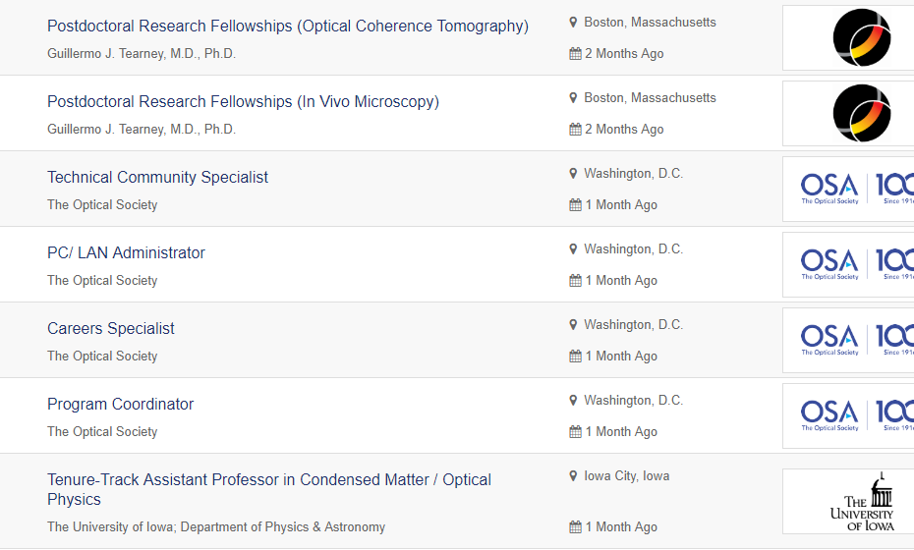
3
其他可用资源
工作机会
https://jobs.workinoptics.com/jobs
Notes:
In USA

Slide 32
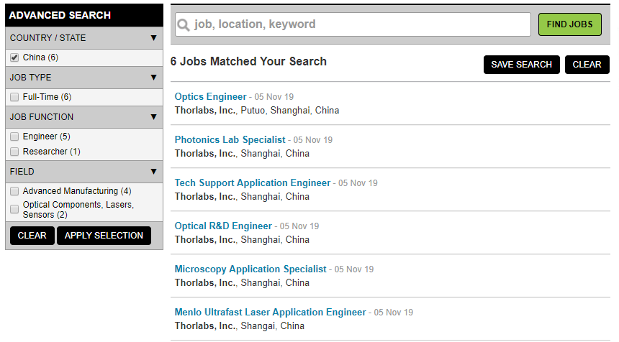
3
其他可用资源
工作机会
https://spiecareercenter.org/jobs
Notes:
In china

Slide 33
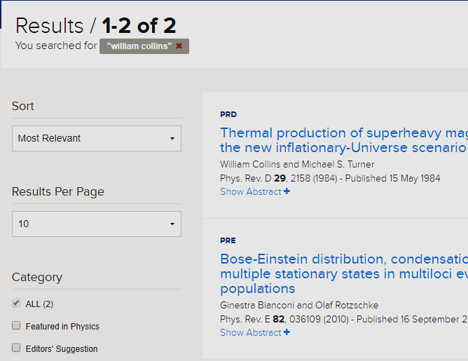
4
养成良好的数据库使用习惯
避免过量下载
Notes:
Read abstract before read the full-text! View of abstract will not be counted in by the platform and therefore will not trigger an abuse!

Slide 34
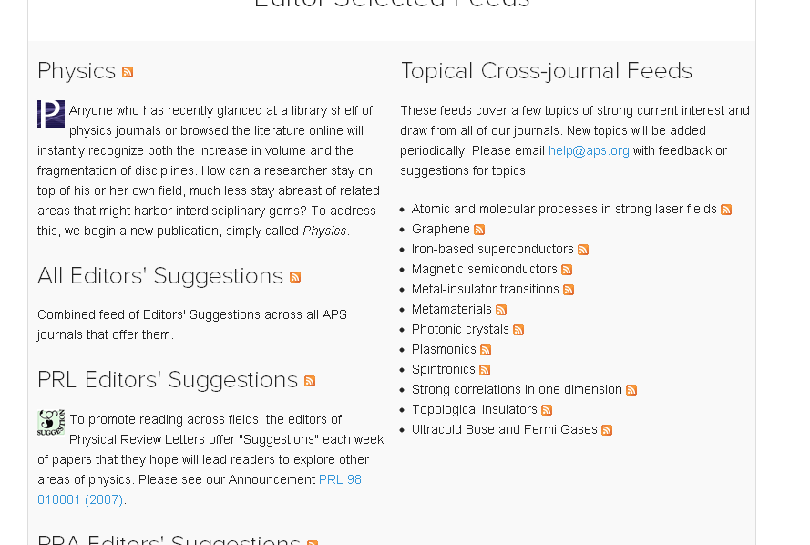
4
养成良好的数据库使用习惯
订阅科技杂志
https://physics.aps.org
点击Physics旁边的订阅图标
将弹出页面的网址复制到电脑中的RSS阅读软件上，增加订阅选项，即可通过IE浏览器或RSS阅读软件浏览订阅内容。
Notes:
Physics is a Sci&Tech Magazine which highlights interesting research activities and findings in the field of Physics.
Editors regularly notify Physics, APS's daily online news and commentary publication, about important Letters, resulting in coverage such as
Viewpoint: Closing the Door on Einstein and Bohr’s Quantum Debate
Viewpoint: The First Sounds of Merging Black Holes.

Slide 35
4
养成良好的数据库使用习惯
订阅科技杂志
https://physics.aps.org
邮件订阅：我们可以转发给您！
只需发送“Physics”至news@igroup.com.cn。
Notes:
邮件订阅Physics周报为什么不行？因为出版社的订阅页面的验证码被国内网络block掉了！没关系，发送“Physics”给我们，我们转发中文版的周报给您！

Slide 36
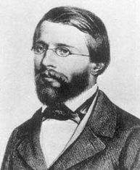
课后作业：
请在APS、OSA、SPIE数据库检索一篇由诺贝尔物理学奖得主主笔或合著的文章，下载PDF全文后，发送至news@igroup.com.cn。
注意：
可以是任意一年的诺贝尔物理学奖得主！
可以来自任意APS、OSA、SPIE出版物！
最先发送邮件的三位同学可获得纪念奖品！
TRY ME…
NOT ME…

